Slide 1

Nature of User

Slide 2
The User
The user is the most important entity of the system

Slide 3
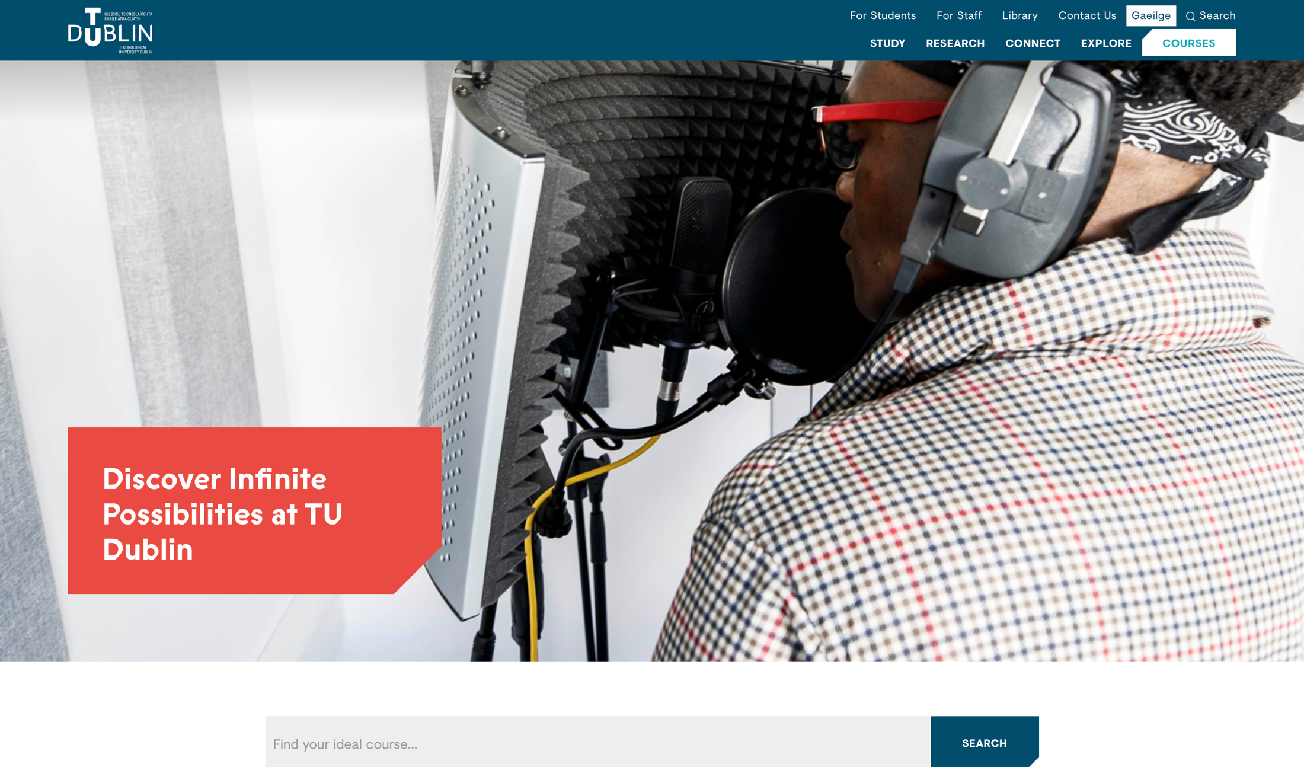
TU Dublin

Slide 4

TU Dublin
What kind of people use the TU Dublin website?

Slide 5
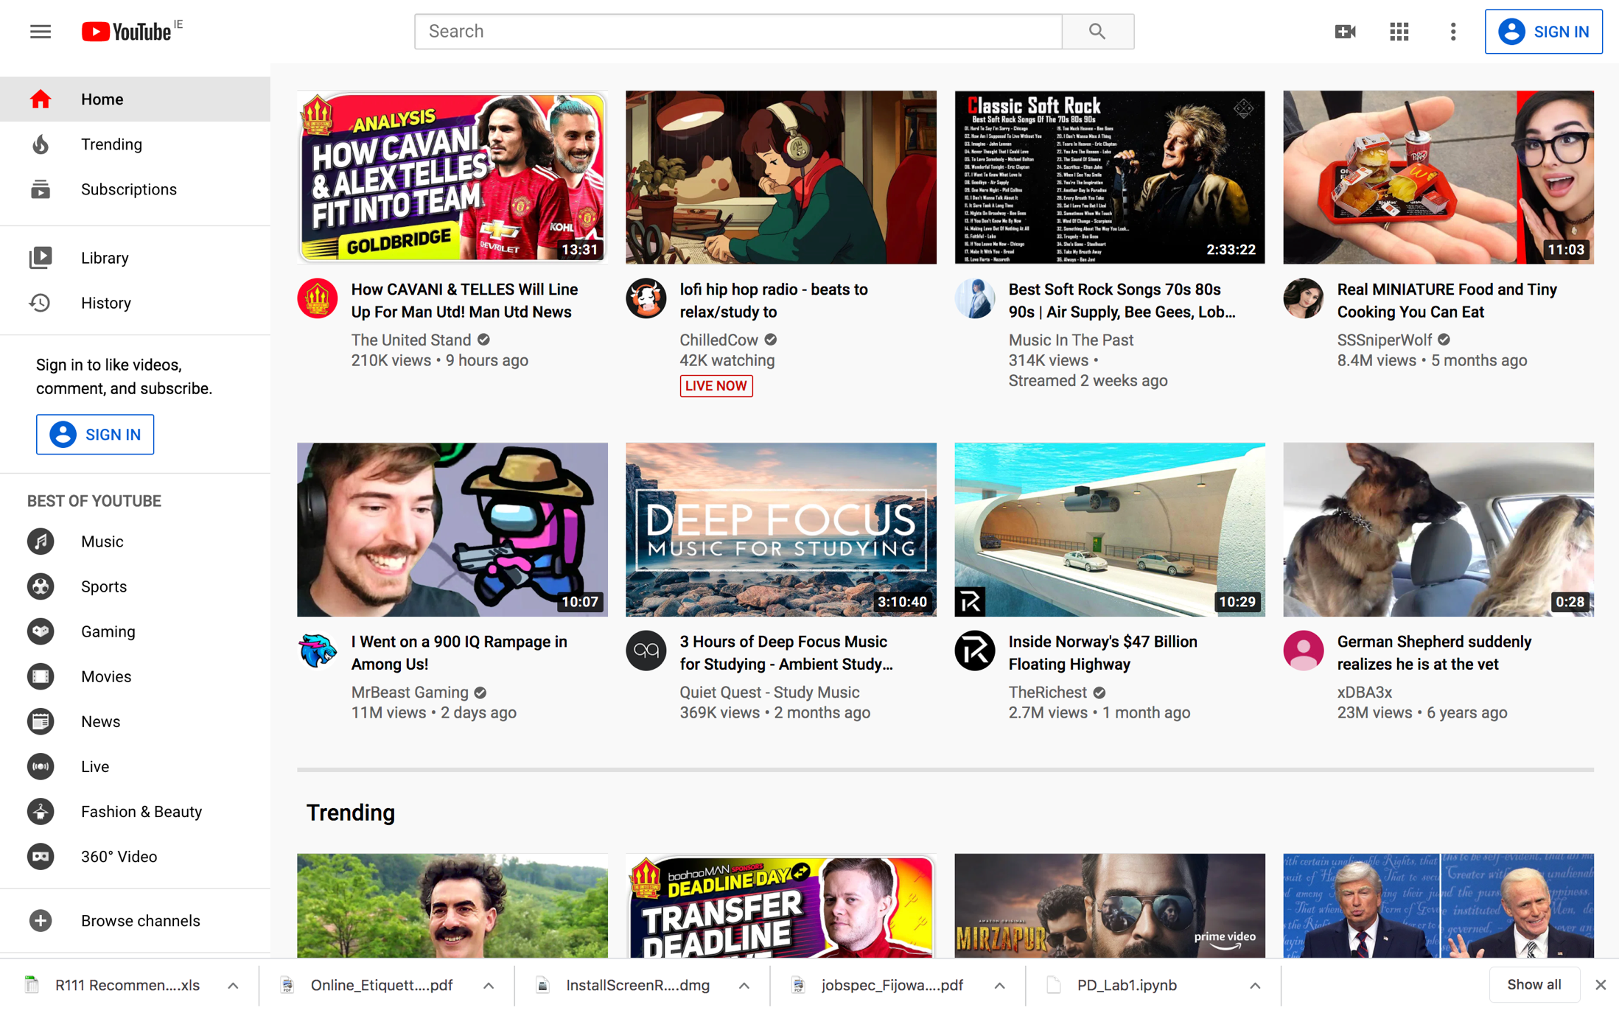
Youtube

Slide 6

Youtube
What kind of people use the Youtube website?

Slide 7
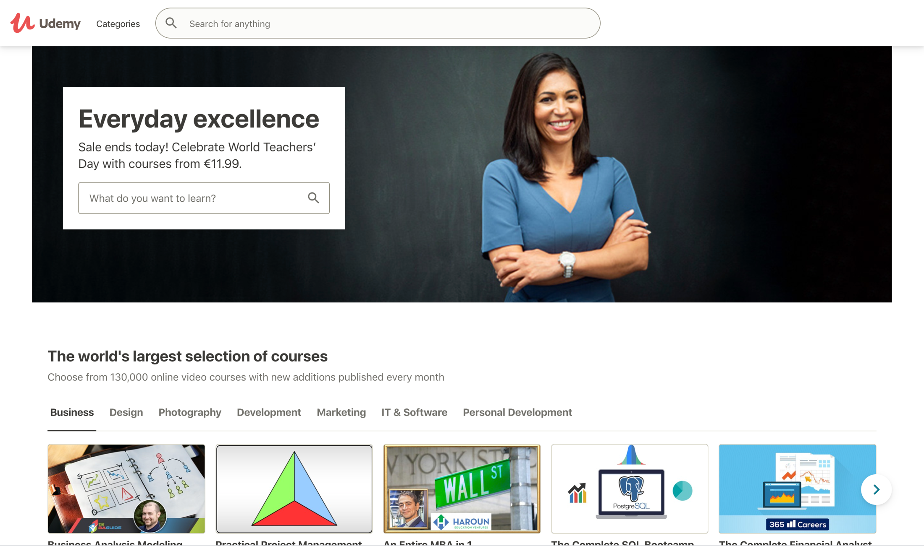
Udemy

Slide 8

Udemy
What kind of people use the Udemy website?

Slide 9
Nature of User
Many different categories of users, impossible to consider all
Can you group users?

Slide 10
Nature of User
User Groups
Computer skills
& knowledge
Disabilities
Age
Cultural
Nature of User

Slide 11
Computer Skills & Knowledge
Nondiscretionary Users
computer is part of employment
time and effort in learning to use computer are willing invested
high motivation is often used to overcome low usability characteristics
Flight reservations clerk, programmer etc.
Nature of User

Slide 12
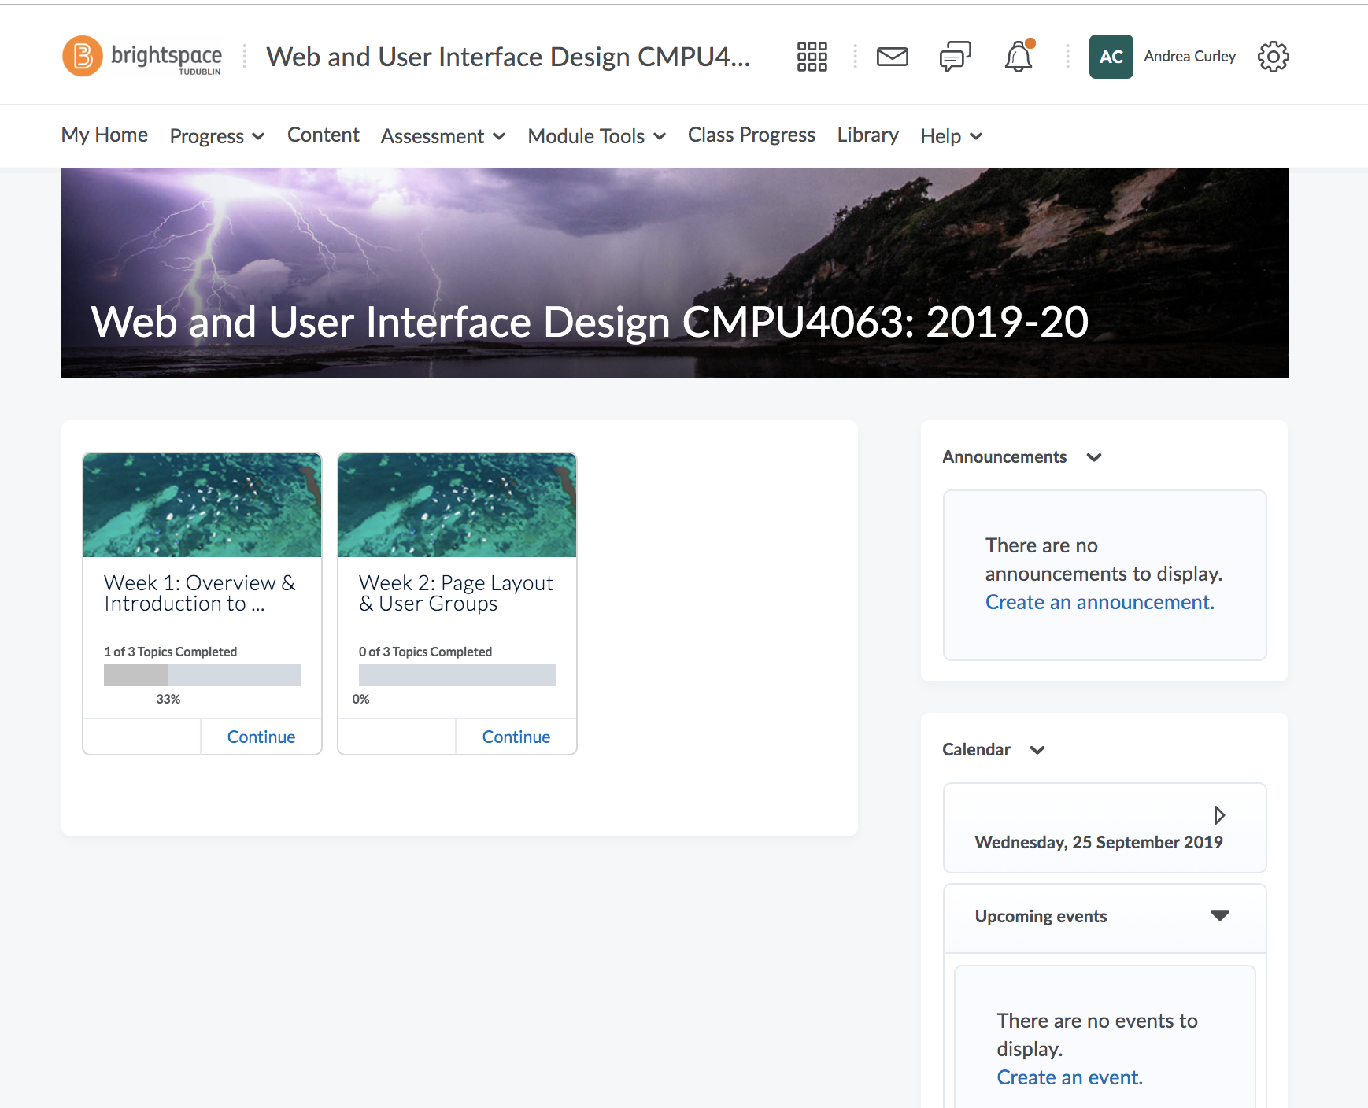
What system are you a non-discretionary user of?
Nature of User

Slide 13
Computer Skills & Knowledge
Discretionary Users
more self-directed, not told how to work
it’s the results, not the means that are more important
utilisation of system not necessary
will not invest extra effort to use the system
does not show high motivation to use system
is easily disenchanted
Nature of User

Slide 14

What system am I a discretionary user of?
Nature of User

Slide 15
Computer Skills & Knowledge
Impact on Design
Novice Users
System features should assist recognition memory - menus, prompts, help screens
Need restricted vocabularies, simple tasks, small number of possibilities and information feedback
View practice as an aid to moving up to expert status
Expert Users
Rely upon free recall
need less information feedback
Seek efficiency by bypassing novice memory aids, reducing keystrokes and summarising information
Nature of User

Slide 16
Age
Ageing User
mobility
vision
Impairments
due to age
hearing
memory
Loss of confidence
Difficulty in orientation
Absorption of information
Nature of User

Slide 17
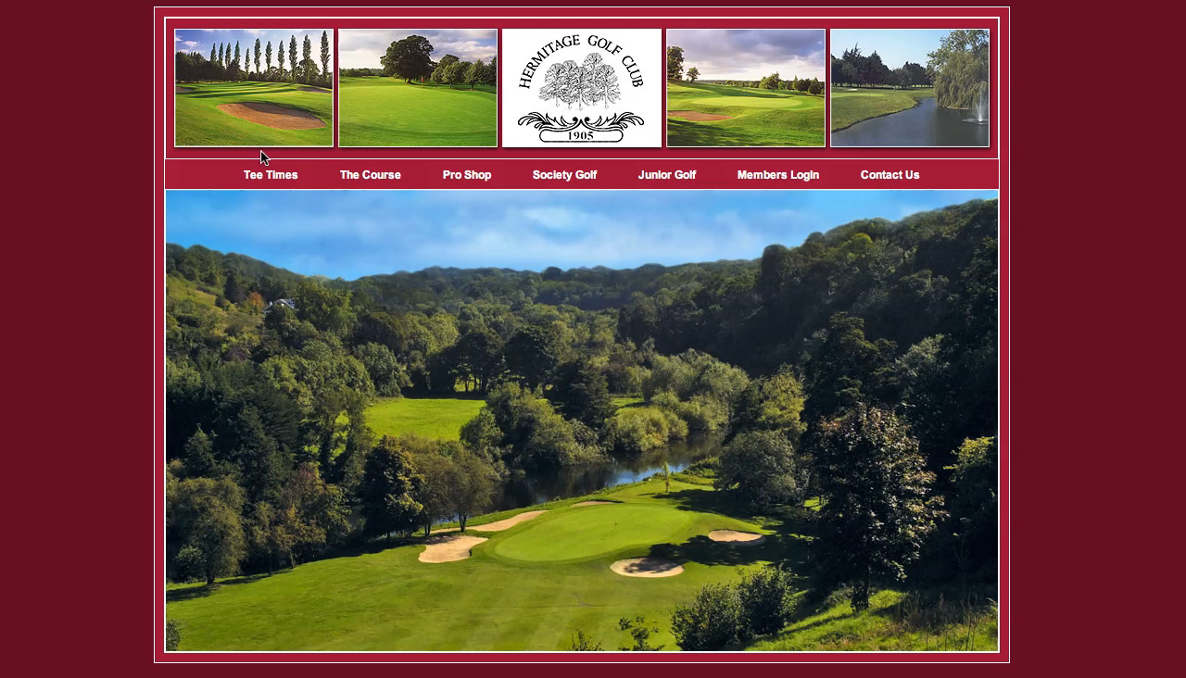
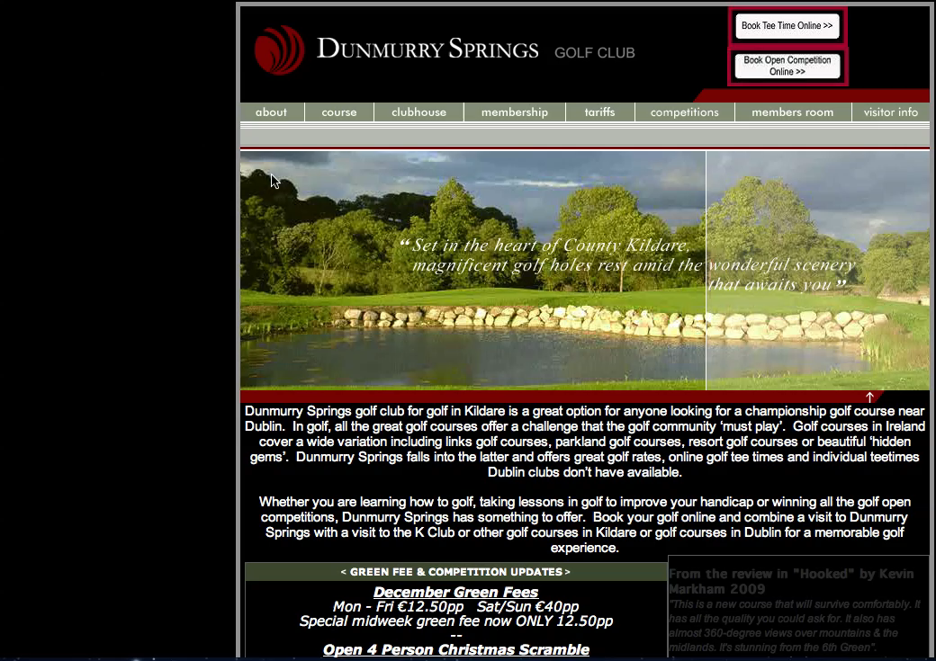
Age: Ageing User
Here are two websites used by a specific male ‘ageing’ user
Hermitage Golf Club
Dunmurry Golf Club

Slide 18
Hermitage Golf Club Website
Nature of User

Slide 19
Dunmurry Springs
Nature of User

Slide 20
Age: Ageing User
How did the user view these 2 sites?
Hermitage Golf Club
Badly structured, different layouts
Left sided menu not usable, could not see further into website without clicking, no drop down menu
Lack of club house, bar and restaurant picture though big parts of club
Information inaccurate
Dunmurry Golf Club
The opposite to all of the above!

Slide 21
Age
Design Guidelines
Simplify screen design
Provide users with simple linear search spaces with few options
Increase size of fonts and controls
Reduce both windows management tasks and scrolling
Ensure contrast between text and background
Menus can introduce problems, toolbars may be an alternative
Ageing User
Nature of User

Slide 22
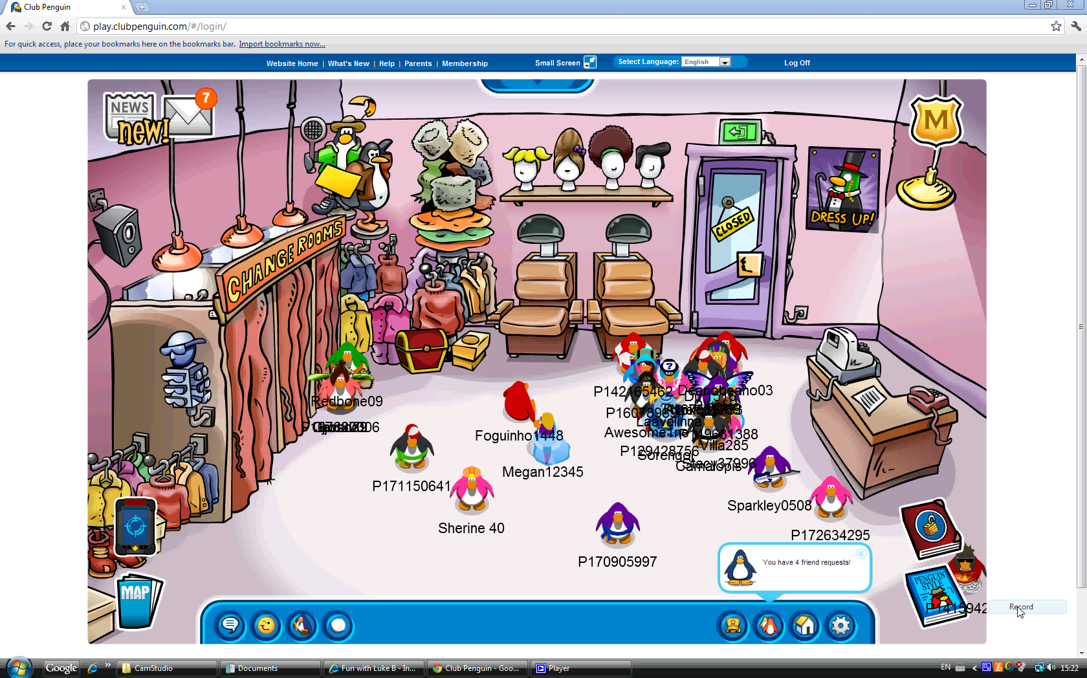
Exercise 2
O.K. now let’s discuss the reasons for this…

Slide 23
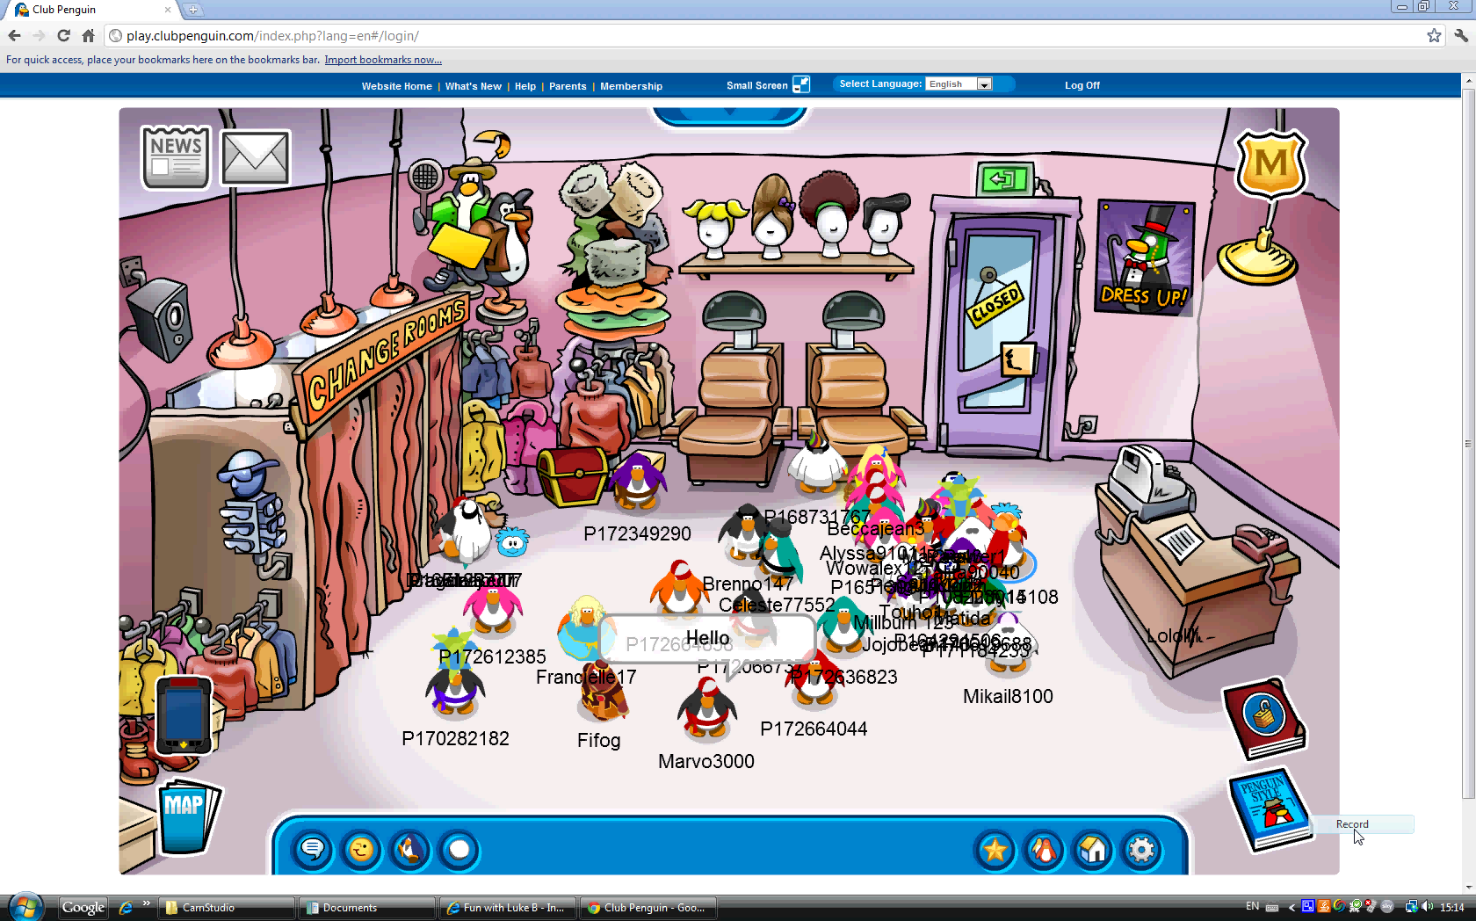
Exercise 2
Spend 5 minutes writing down ideas as to why you think desktop computers don’t have handles on them to make them easier to carry.

Slide 24
Age
Young User
Active learners drawing on physical and social experiences
Learn by doing
Require something that they can see, touch and hear
Prior to the age of 8, children rely on visual and auditory perception for knowledge
Learning is through first hand experience
Nature of User

Slide 25
Age
Young User
Design Guidelines
Activities are open-ended and discovery-oriented
Interaction encourages child-initiated play
Involve active manipulation and transformation of real materials
Entry-level knowledge and skill is kept to a minimum
Provision is made for children’s varied skill and ability levels
Construction activities that involve design, creation and evaluation processes form the basis of interactions
Nature of User

Slide 26
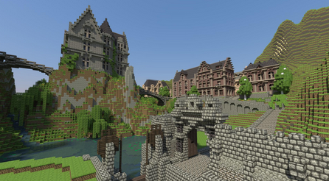
Young User
Nature of User

Slide 27

Young User
Nature of User

Slide 28
Disabilities
Designers must plan early to accommodate users with disabilities
Needs are more critical
Disabled users can be categorised as follows:
Physically disabled users
Cognitively disabled users
Nature of User

Slide 29
Disabilities
Physically Disabled
Impairments can include lack of mobility, low vision, blind and hearing
Nature of User

Slide 30
Disabilities
Physically Disabled (cont.)
Design Guidelines (Jakob Nielsen)
Provide keyboard access to application features
Follow key-mapping guidelines or the local environment
Avoid placing frequently used functions deep in a menu structure
Do not hard-code colours, graphics, or font sizes and styles
Provide visual information that is redundant with audible information
Allow users to configure frequency and volume of audible cues
Nature of User

Slide 31
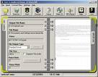
Disabilities
Cognitively Disabled
Examples of cognitive impairments would be learning disabilities, dyslexia and poor memory
Changes can be made to accommodate these users by improving layouts, controlling vocabulary, and limiting short-term memory demand
Nature of User

Slide 32
Disabilities
Cognitively Disabled
Social inclusion is most important
Access to information is critical to social inclusion and increasingly reliant on technology
Some research shows that these users have the same problems with web-sites as other users but with greater severity
Access to textual information is difficult
Nature of User

Slide 33
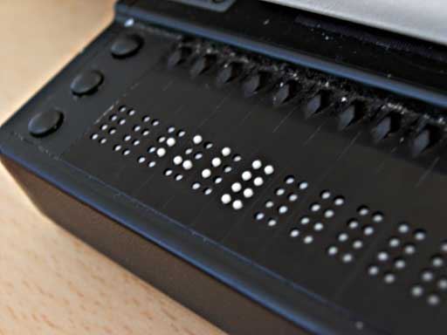
Assistive Technologies
Refreshable Braille Display for visually impaired users
Nature of User

Slide 34
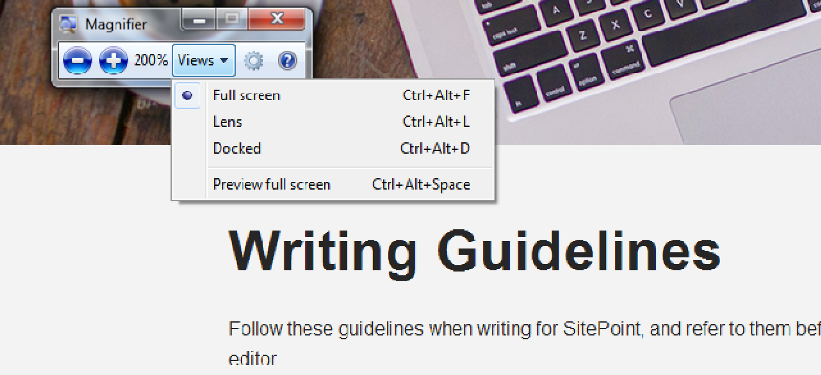
Assistive Technologies
Screen magnifiers
Nature of User

Slide 35
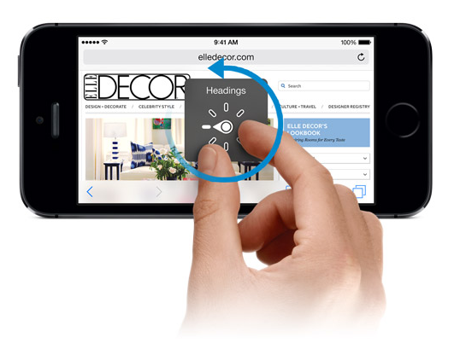
Assistive Technologies
iOS Voice Over
Nature of User

Slide 36
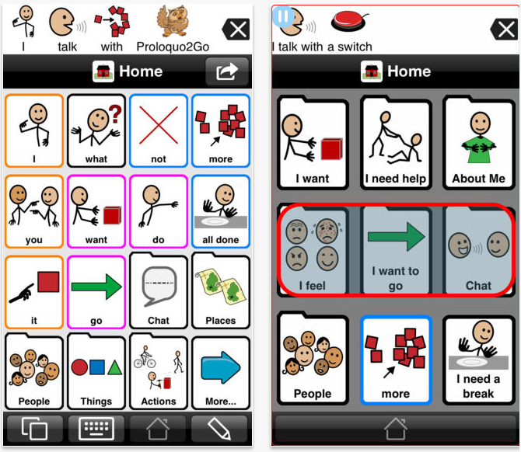
Assistive Technologies
Proloquo2Go – communication app that provides vocal abilities to those who cannot speak.
Nature of User

Slide 37

Assistive Technologies
Speech Recognition Software
Nature of User

Slide 38
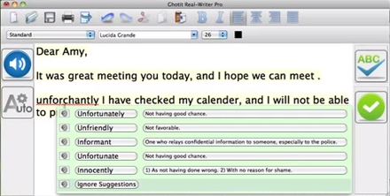
Assistive Technologies
Reader & Writer Software-Ghotit Real Writer is for users with dyslexia and dysgraphia
http://www.sitepoint.com/assistive-technology-that-means-screen-readers-right/

Slide 39
Assistive Technologies
An extensive list of technologies are available at:
http://www.assistireland.ie/eng/Products_Directory/

Slide 40
Culture
Cultural and international diversity
Characters, numerals, special characters, and diacriticals
Left-to-right versus right-to-left versus vertical input and reading
Date and time formats
Numeric and currency formats
Weights and measures
Telephone numbers and addresses
Names and titles (Mr., Ms., Mme.)
Social-security, national identification, and passport numbers
Capitalization and punctuation
Sorting sequences
Icons, buttons, colors
Pluralization, grammar, spelling
Etiquette, policies, tone, formality, metaphors
Nature of User

